Slide 1
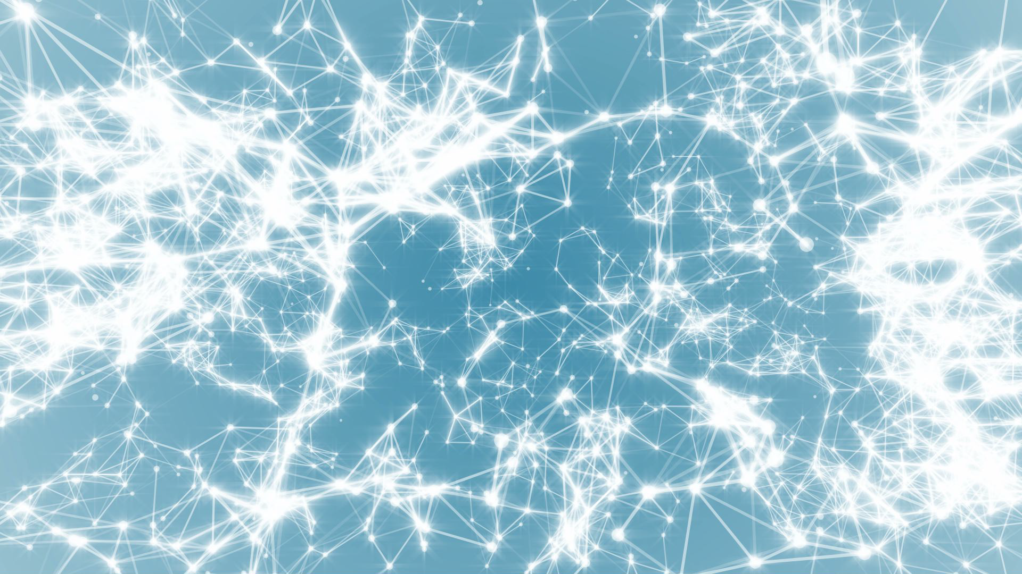
Frontiers of Network Science
Fall 2023
Class 1: Introduction
(Chapter 1 in Textbook)
Boleslaw Szymanski
based on slides by Albert-László Barabási & Roberta Sinatra

Slide 2
Syllabus - Fall2022
Course CSCI-6250/4250 4cr: Frontier of Network Science
Monday - Thursday 12:00 - 13:40, Amos Eaton 216
Class Web-site
http://www.cs.rpi.edu/~szymansk/fns.23/index.php
Instructor: Prof. Boleslaw K. Szymanski, email: szymab@rpi.edu
Office Hours: Monday 15:00 – 16:00, Wednesday 13:00 – 14:00 webex by appointment
Textbooks
Albert Laszlo Barabasi Network Science
Cambridge University Press, 2016
On-line version is available at http://barabasi.com/networksciencebook/
In addition, class notes will be used.

Slide 3
Course Description
This course offers an introduction to Network Science and a review of current research in this field. Classes will interchangeably present chapters from the textbook and the related current research. The emphasis will be on the mathematical background of network science: graphs and networks; random networks and various types of scale-free networks; and on network properties such as assortativity, mobility, and robustness; social networks and communities; and dynamics of processes on networks.
Course Content
• Mathematical background of network science: graphs and networks.
• Random networks and their properties.
• Scale-free networks, small world networks and Barabasi-Alert model.
• Mobility and networks
• Network robustness
• Social networks and communities
• Assortativity of networks
• Dynamic processes

Slide 4
Grading Criteria
Undergraduates:
One individual programming homework (40% of the total grade), followed by one individual presentation of the selected research paper or textbook problem (50% of the total grade), with questions and participation in discussions for at least two student presentations will providing the remaining (10%) of the total grade.
The programming homework will be handed out approximately after the end of the 4th week, together with choices of networks for experiments, and due in three weeks after that. The homework will require using network analysis tools (or programming) and analysis of the results obtained for the real and synthetic networks. The graded homework will be returned to undergraduates approximately one week after they are handed in. Students will have these grades as their means to determine progress in the course by mid-semester.
Students need to choose a topic for research and presentation either from the list of problems associated with the textbook or from the seminal papers that need to be approved by the instructor by the 7th week. The 25 min in class presentation + 5 min discussion of the assigned topic will be scheduled starting at the end of October.

Slide 5
Grading Criteria
Graduates:
Students will choose a topic for research and presentation either from the list of the seminal papers, or from their own current work, and approved by the instructor during the first two weeks of the class.
Around 6th week of the course, the research plan will be due of 3-5 pages defining the project part of the presentation on which research will be based (20%).
The 45 min presentation of the length of typical research length, followed by 5 min discussion will be due to be presented and delivered starting at the end of October (50%).
A written report of 8-12 pages due at the last class (20%). The remaining 10% of the grade will be assigned based on participation in discussions of the presentations.
Grade range for both graduates and undergraduates:
A 96. A- 91, B 85, B- 80, C 70, C- 60, F <60.

Slide 6
Student Learning Outcomes
Student Learning Outcomes:
Upon completion of this course, all students will be able to:
Apply fundamental network science ideas to create models and understand dynamics of networked systems;
Compare, contrast, and describe the similarities and differences of different kinds of networks and processes modeled on networks;
Critique the strengths and weaknesses of each of the models and types of networks based on them and these network types performance in diverse network science applications;
Understand the principles of applying network science to disciplinary science and design and set up basic models for some specific applications.
Additionally, graduate students will also be able to:
Read, analyze, and critique published literature in the field of network science and social networks;
Assess novelty of network science research and its relation to the state of the art in the field.

Slide 7
Course Assessment Measures
Undergraduates: Students' performance will be measured using three different methods:
(i) Programming homework
(ii) After selection of a current research paper or textbook problem for presentation, students will presentation the selected papers, including their content, and evaluate their scientific results.
(iii) Contributions to in-class discussions
The programming homework and presentation plans will measure the student's ability to apply concepts of network science to networks analysis.
The presentation and discussion of the paper results will measure student's ability to prepare summary material based on fundamental scientific concepts and basic research.
In-class discussion will measure students’ ability to express their views at group meetings.
Graduates: Again, students' performance will be measured using three different methods:
(i) After selection of a current research paper or own research for presentation, students will presentation the selected topics, including content, and evaluate their scientific results.
(ii) Contributions to in-class discussions
(iii) Independent and novel mini-project on the topic of the presentation using different data, or methods.
The first two methods are the same as undergraduate methods (i) and (iii), while the third method assesses students’ ability to apply network science tools to novel problems

Slide 8
Academic integrity:
Student-teacher relationships are built on trust. For example, students must trust that teachers have made appropriate decisions about the structure and content of the courses they teach, and teachers must trust that the assignments that students turn in are their own. Acts, which violate this trust, undermine the educational process. The Rensselaer Handbook of Student Rights and Responsibilities defines various forms of Academic Dishonesty and all students should make themselves familiar with these forms to avoid them.
In this class, all assignments that are turned in for a grade must represent the student's own work. Submission of any assignment that is in violation of this policy will result in a penalty of 0 points for assignment and failing of the course in case of repetition.
If you have any question concerning this policy, please ask for clarification before preparing or submitting an assignment or making a presentation.
The penalty for not adhering to these academic integrity rules is a failing grade for the assignment on the first offense, then failing the course and potential disciplinary actions by the Institute on any subsequent offenses.

Slide 9
Attendance Policy:
Attendance in classes is in general not required but it is recommended because the material presented in classes includes topics beyond the textbook.
However, the attendance and active participation is required in at least two research presentations with active participation is needed to receive score for active participation.
Missed deadline for homework, unless justified by medical or personal reasons and approved by instructor, will lower the achieved score by 10% for each week of delay.
Presentations can be rescheduled but only in emergencies.

Slide 10
Calendar:
The list shows the topics covered in classes, brown are lectures based on textbook, green are research presentations, and blue are presentations by students.
Aug. 28: L01 Overview and Introduction to Network Science/Graph Theory (chapter 1)
Aug. 31: L02 Introduction II (chapter 1)
Sept. 05: L03 Graph Theory (chapter 2) topics for student presentations;
Sept. 07: L04 Graph Theory II (chapter 2)
Sept. 11: L05 Random Networks (chapter 3)
Sept 14: Deadline for research topic selections by graduates due before noon
Sept. 14:L06 Scale Free Networks (chapter 4);
Sept. 18: L07 Research: U.S. Senate Clustering; U.S. Congress Polarization II; (Constitution Day)
Sept. 21: L08 Introduction to Gephi + Examples; Undergraduate Assignment out, due Oct. 16
Sept. 25: L09 Q&A session for H1; Barabasi-Albert Model (chapter 5);
Sept. 28; Deadline for undergraduates to register their networks before noon
Sept. 28: L10 Barabasi-Albert Model (chapter 5);
Oct. 02: L11 Barabasi-Albert Model II (chapter 5);
Oct. 05: Deadline for research plan writes up by grads before noon
Oct. 05: L12 Degree Correlation (chapter 7)
Oct. 12: L13 Degree Correlation II (chapter 7)
Oct. 16: Graduate research plan write ups and undergraduate assignment are due before midnight

Slide 11
Section 2: FROM SADDAM HUSSEIN TO NETWORK THEORY
FROM SADDAM HUSSEIN TO NETWORK THEORY
Network Science: Introduction

Slide 12
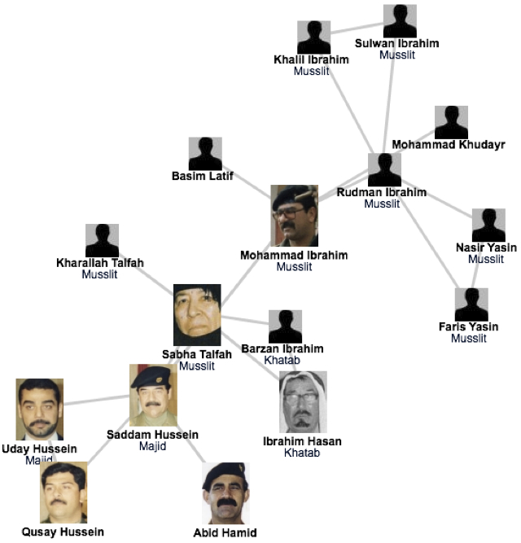
A SIMPLE STORY (1) The fate of Saddam and network science
Network Science: Introduction
Network Science: Introduction
Notes:
Invasion that started in March 19, 2003. Many of the regime's high ranking officials, including Saddam Hussein, avoided capture.
Hussein was last spotted kissing a baby in Baghdad in April 2003, and then his trace went cold.
designed a deck of cards, each card engraved with the images of the 55 most wanted.
It worked: by May 1, 2003, 15 men on the cards were captured, and by the end of the month another 12 were under custody.
Yet, the ace of spades (see Figure), i.e. Hussein himself, remained at large.
Col James Hickey, in charge of a series of raids known Operation Desert Scorpion, wanted to know the relationship between everyone killed or captured. The task fell to Lt. Col. Steve Russell, who was in direct charge of the raids. Then there was Brian Reed, the operations officer under Col. Hickey, who was exposed to social networks during his studies at West Point.
Realizing that capturing the faces of the Iraq regime was of little help in cornering Saddam himself, these men started to systematically reconstruct the social network of Saddam's inner circle. They did not rely on government documents and decrees, but rather gossip and family trees. Instead of focusing on military titles, they learned to understand the five names each Iraqi man had, listing the name of their father, grandfather, and the city of origin-- serving as a family tree.
As they meticulously pieced together an extensive diagram of who drank with whom and who is related to whom in the Tikrit region, where Saddam was from, they started to use network diagrams to guide the raids. In one of those raids they found over \$8 million in US currency, about \$1 million in Iraqi currency, jewelry worth over \$2 million, rifles and ammunition. Yet, the biggest prize was Saddam's family photo album, providing the faces of those that the family trusted, filling with intimate details their growing network diagram.
Their increasingly detailed maps consistently pointed to two individuals, Rudman Ibrahim and Mohammed Ibrahim. They served instead as Saddam's second-level bodyguards, numbering about 40 who ran the daily tasks, serving as his driver, cook, or mechanic.
Yet, Rudman, whom the investigators believed that he knew Hussein's whereabouts, had a heart attack and died within a few hours of his capture.
Next the investigators used their network diagram to identify individuals who could have known the whereabouts of Mohammad, dubbed the "fat man". Not a major player in the regime's power structure, while Saddam's whereabouts kept secret, Mohammed's social ties were not as protected as Saddam's.
once they found someone to turned Mohammed Ibrahim in, the same man escorted them to a farm near the Tigris river, reveling the spider hole that hid the dictator himself.

Slide 13
Thex
A SIMPLE STORY (1) The fate of Saddam and network science
The capture of Saddam Hussein:
shows the strong predictive power of networks.
underlies the need to obtain accurate maps of the networks we aim to study; and the often heroic difficulties we encounter during the mapping process.
demonstrates the remarkable stability of these networks: The capture of Hussein was not based on fresh intelligence, but rather on his pre-invasion social links, unearthed from old photos stacked in his family album.
shows that the choice of network we focus on makes a huge difference: the hierarchical tree, that captured the official organization of the Iraqi government, was of no use when it came to Saddam Hussein's whereabouts.
Network Science: Introduction
Network Science: Introduction

Slide 14
Section 3 VULNERABILITY DUE TO INTERCONNECTIVITY
VULNERABILITY DUE TO INTERCONNECTIVITY
Network Science: Introduction

Slide 15
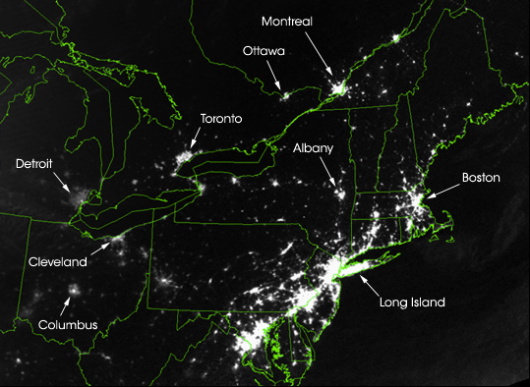
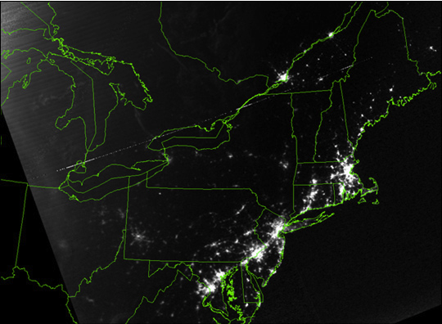
Thex
A SIMPLE STORY (2): August 15, 2003 blackout.
August 14, 2003: 9:29pm EDT
20 hours before
August 15, 2003: 9:14pm EDT
7 hours after
Network Science: Introduction
Network Science: Introduction
Notes:
At a first look the two satellite maps of Image 1.3a/b are indistinguishable: lights shining brightly in highly populated areas, and dark spaces marking vast uninhabited forests and oceans. Yet, upon closer inspection something strange becomes apparent. The light in several regions, Toronto, Detroit, Cleveland, Columbus, Long Island have simply disappeared. This is not a doctored shot from the next Armageddon movie but represents a real image of the US Northeast on August 14, 2003, the night of a blackout that left an estimated 45 million people in eight US states and another 10 million in Ontario without power. It illustrates a much ignored aspect of networks, one that will be an important theme in this book: vulnerability due to interconnectivity.
The 2003 blackout is a typical example of a cascading failure. When a network acts as a transportation system, a lo- cal failure shifts loads to other nodes. If the extra load is negligible, the rest of the system can seamlessly absorb it, and the failure remains effectively unnoticed. If the extra load is too much for the neighboring nodes to carry, they will either tip or redistribute the load to their neighbors. Either way, we are faced with a cascading failure, the magnitude of which depends on the network position and capacity of the nodes that have been removed in the first and subsequent rounds. Case in point is electricity: as it cannot be stored, when a line goes down, its power must be shifted to other lines. Most of the time, the neighboring lines have no difficulty carrying the extra load. If they do, they will also tip and redistribute their increased load to their neighbors.
Cascading failures can occur in most complex systems. They take place on the Internet, when traffic is rerouted to bypass malfunctioning routers, occasionally creating denial of service attacks on routers that do not have the capacity to handle extra traffic. We witnessed one in 1997, when the International Monetary Fund pressured the central banks of several Pacific nations to limit their credit. There was a cascading failure behind the 2009-2011 financial melt- down, when the US credit crisis paralyzed the economy of the globe, leaving behind scores of failed banks, corporations, and even bankrupt states. Cascading failures are occasionally our ally, however. The world wide effort to dry up the money supply of terrorist organizations is aimed at crippling terrorist networks, and doctors and researchers hope to induce cascading failures to kill cancer cells.
The Northeast blackout illustrates an important theme of this book: we must understand how the network structure affects the robustness of a complex system. We will there- fore develop quantitative tools to assess the interplay between network structure and dynamical processes on net- works and their impact on failures. Although such failures may appear chaotic and unpredictable, we will learn that they follow rather reproducible laws that can be quantified and even predicted using the tools of network science.

Slide 16
Section 4 NETWORKS AT THE HEART OF COMPLEX SYSTEMS
NETWORKS AT THE HEART OF COMPLEX SYSTEMS
Network Science: Introduction

Slide 17
Stephen Hawking
January 23, 2000`
Network Science: Introduction

Slide 18
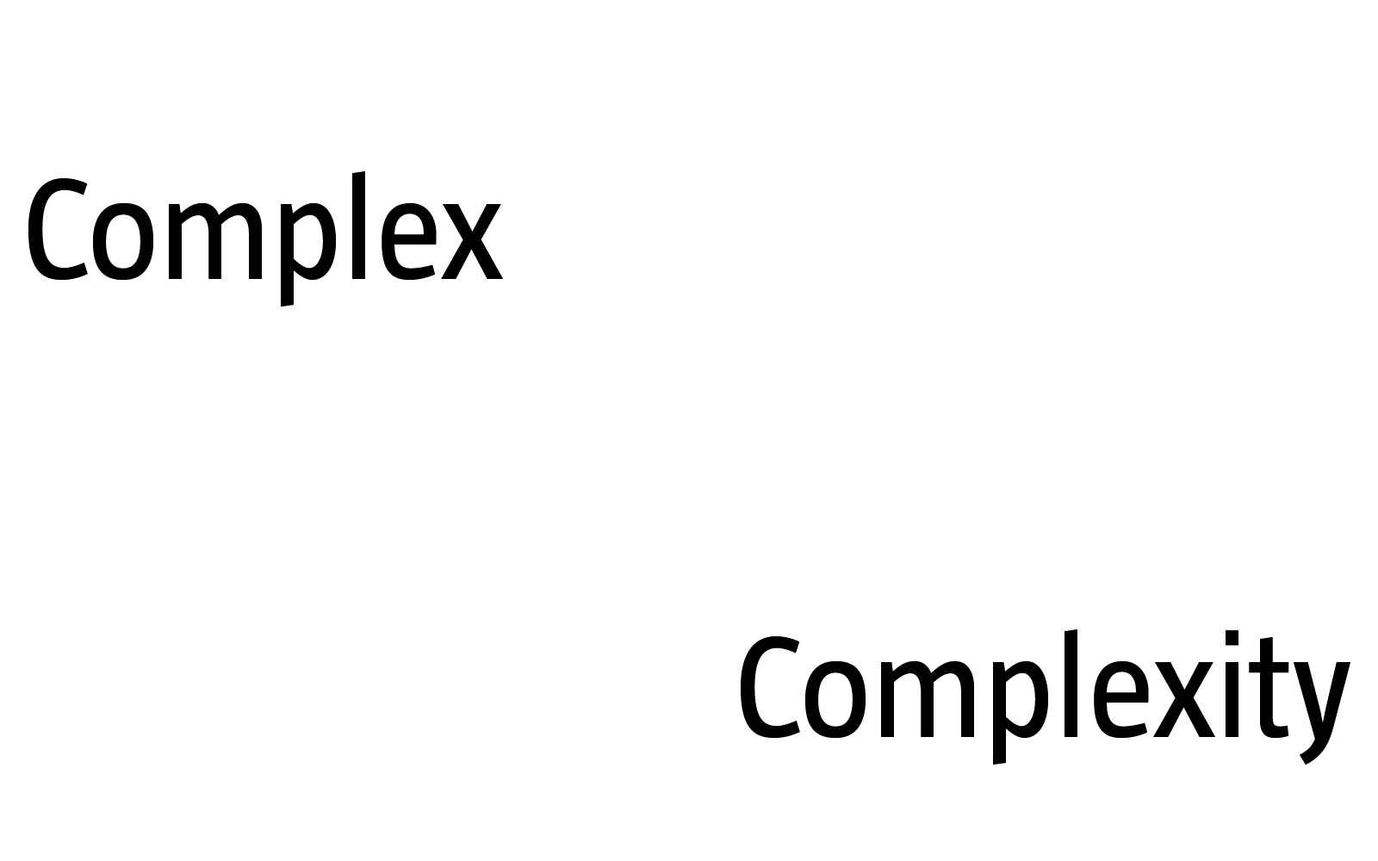
COMPLEX SYSTEMS
Complexity, a scientific theory which asserts that some systems display behavioral phenomena that are completely inexplicable by any conventional analysis of the systems’ constituent parts. These phenomena, commonly referred to as emergent behaviour, seem to occur in many complex systems involving living organisms, such as a stock market or the human brain.
Source: John L. Casti, Encyclopædia Britannica
[adj., v. kuh m-pleks, kom-pleks; n. kom-pleks]
–adjective
1.
composed of many interconnected parts; compound; composite: a complex highway system.
2.
characterized by a very complicated or involved arrangement of parts, units, etc.: complex machinery.
3.
so complicated or intricate as to be hard to understand or deal with: a complex problem.
Source: Dictionary.com
Network Science: Introduction
Notes:
We are surrounded by systems that are hopelessly complicated, from the society, whose seamless functioning requires cooperation between billions of individuals, to communications infrastructures that integrate billions of cell phones with computers and satellites. Our ability to reason and comprehend the world around us is guaranteed by the coherent activity of billions of neurons in our brain. Our very existence is rooted in seamless interactions between thousands of genes and metabolites with- in our cells. These systems are collectively called complex systems. Given the important role they play in our life, in science and economy, the understanding, mathematical description, prediction, and eventually the control of such complex systems is one of the major intellectual and scientific challenges of the 21st century.
The emergence of network theory, at the dawn of the 21st century is a vivid demonstration that science can live up to this challenge. Indeed, behind each complex system, there is an intricate network that encodes the interactions between the system’s components:

Slide 19
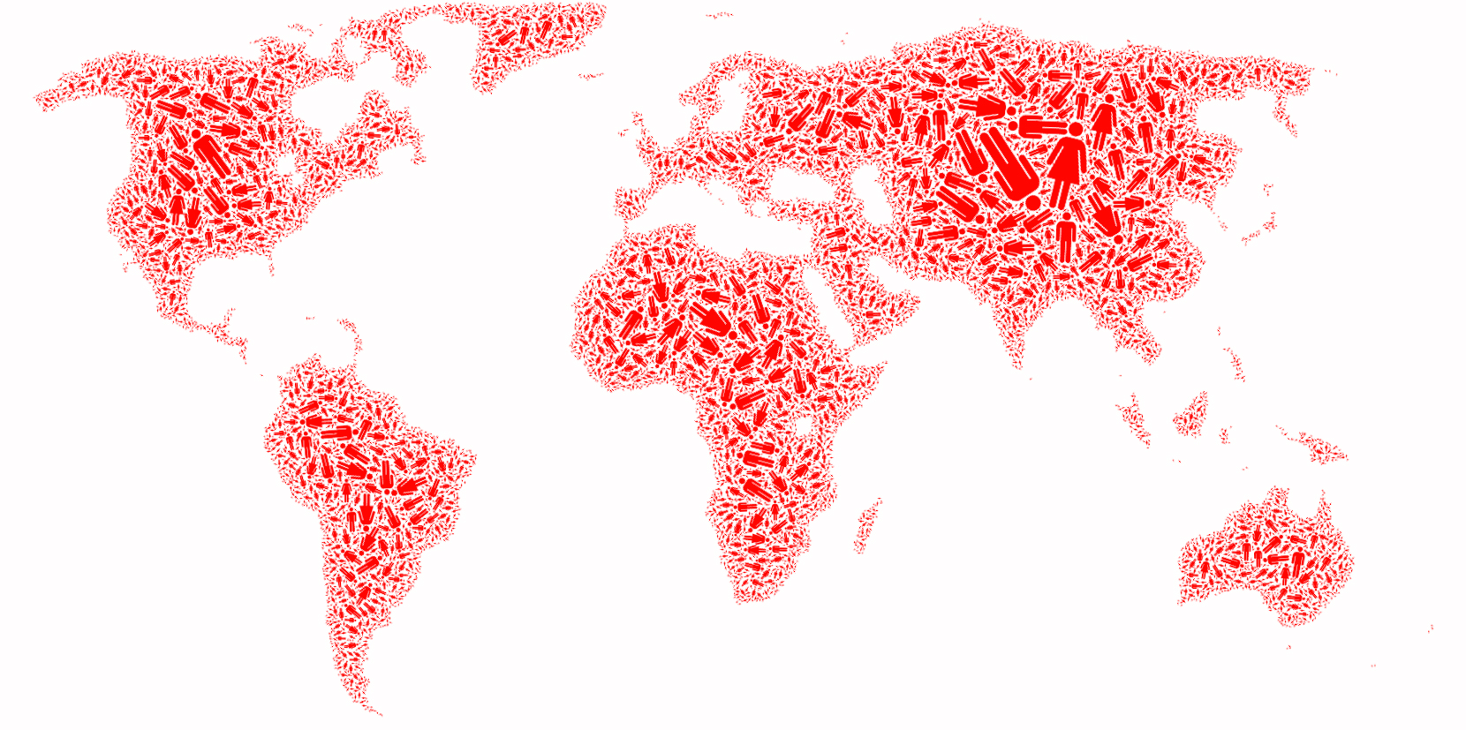
SOCIETY Factoid:
The population of 9-10 billions people has been predicted by the United States Census Bureau to be in 2050.
http://en.wikipedia.org/wiki/World_population
Network Science: Introduction
Notes:
The sum of all professional, friendship, and family ties is the fabric of the society.

Slide 20
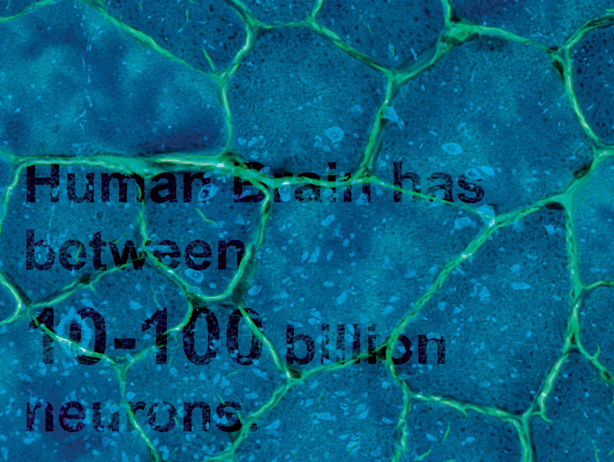
Brain
BRAIN Factoid:
Factoid:
Human Brain has between
10-100 billion neurons.
Network Science: Introduction
Notes:
The wiring diagram capturing the connections between neural cells holds the key to our understanding of brain functions.

Slide 21
ECONOMY Factoid:
The world economy will produce goods and services worth $105 trillion in 2023.
(https://en.wikipedia.org/wiki/World_economy)
Network Science: Introduction

Slide 22
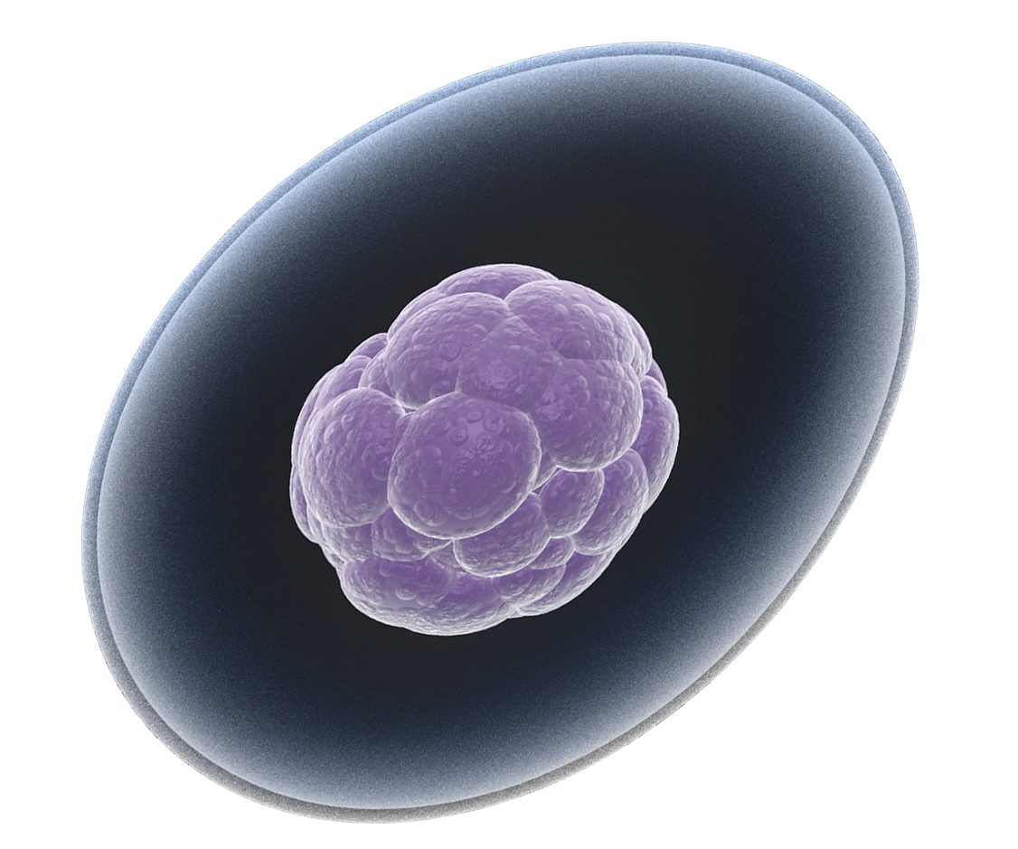
THE HUMAN CELL Factoid:
How Many Genes are in the Human Genome?
The latest number from 2007 is 20,500
The 20,500 number of protein-coding genes was presented in a 2007 PNAS paper. Scientists arrived at this number by excluding the (now thought to be functionally meaningless, random occurrences)
M. Clamp et al., 2007. "Distinguishing Protein-Coding and Noncoding Genes in the Human Genome," PNAS 104(49), 19428-19433.]
20,500
Network Science: Introduction
Notes:
The network describing the interactions between genes, proteins, and metabolites integrates the processes behind living cells.

Slide 23
THE ROLE OF NETWORKS
Behind each complex system there is a network, that defines the interactions between the components.
Network Science: Introduction

Slide 24
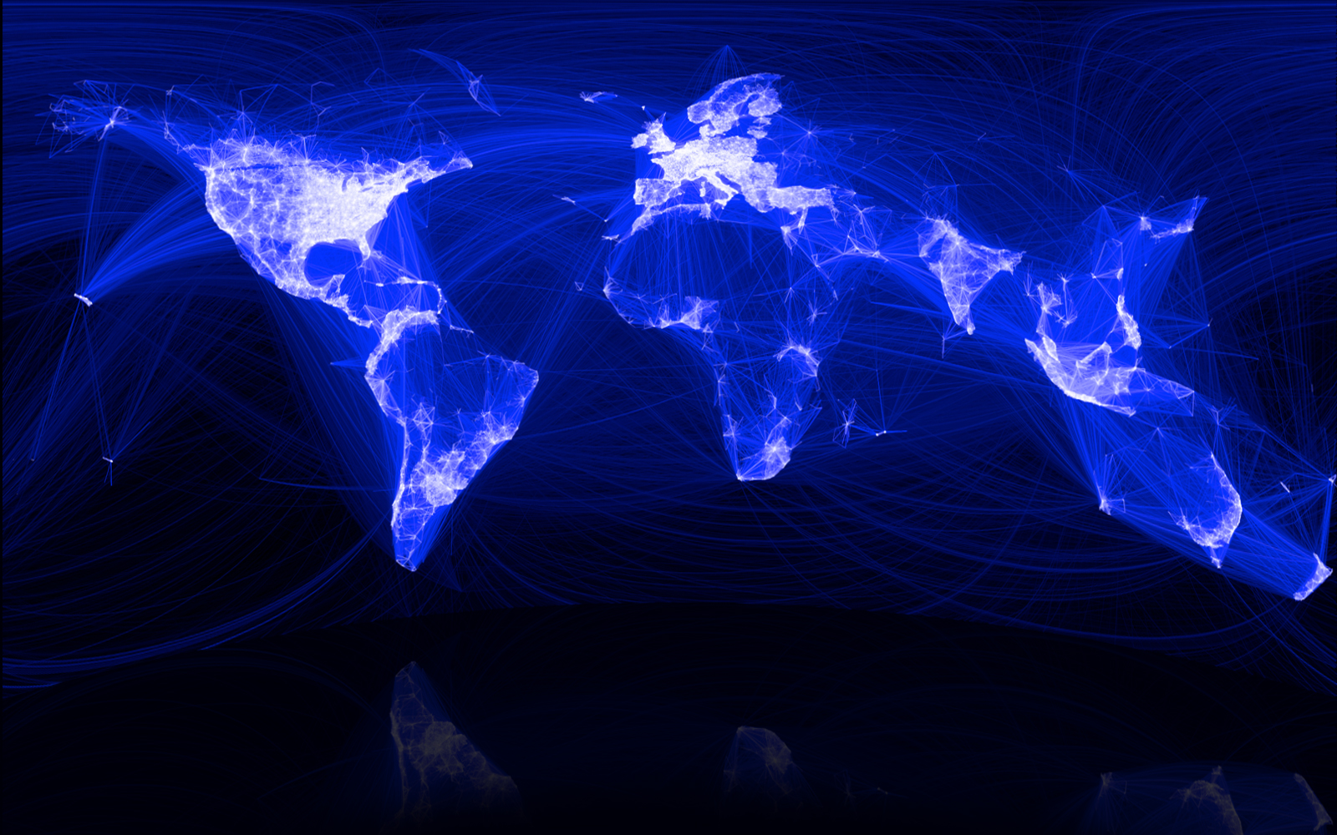
SOCIETY Factoid:
The “Social Graph” behind Facebook
Keith Shepherd's "Sunday Best”. http://baseballart.com/2010/07/shades-of-greatness-a-story-that-needed-to-be-told/
Network Science: Introduction
Notes:
The network describing the interactions between genes, proteins, and metabolites integrate the processes behind living streams. The wiring diagram capturing the connections between neural cells hold the key to our understanding of brain functions. The sum of all professional, friendship, and family ties is the fabric of the society. The network describing which communication devices interact with each other, capturing internet connections to wireless links, is the heart of the modern communication system. The power grid, a network of generators and transmission lines, supplies with energy virtually all modern technology. Trade networks maintain our ability to exchange goods and services, being responsible for the material prosperity that an increasing fraction of the world has enjoyed since WWII (Image 2). They also play a key role in the spread of financial and economics crises. Networks are at the heart of some of the most revolutionary technologies of the 21st century, empowering everything from Google to Facebook, CISCO, and Twitter. At the end, networks permeate science, technology, and nature to a much higher degree than may be evident upon a casual inspection. Consequently, we will never understand complex systems unless we gain a deep understanding of the networks behind them.While network science is a relatively young field, its roots go back several centuries. The scientific explosion of the field has experienced during the first decade of the 21st century is rooted in the discovery that despite the apparent differences, the emergence and evolution of rather different networks is driven by a common set of fundamental laws and reproducible mechanism. Hence despite amazing the diversity in form, size, nature, age, and scope present in real networks, most networks observed in nature, society, and technology are driven by common organizing principles. In other words once we disregard the nature of the components and their interactions, the obtained networks appear to be more similar than different from each other. In the following sections we discuss the forces that have led to the emergence of this new research field and its impact on science, technology, and society.

Slide 25
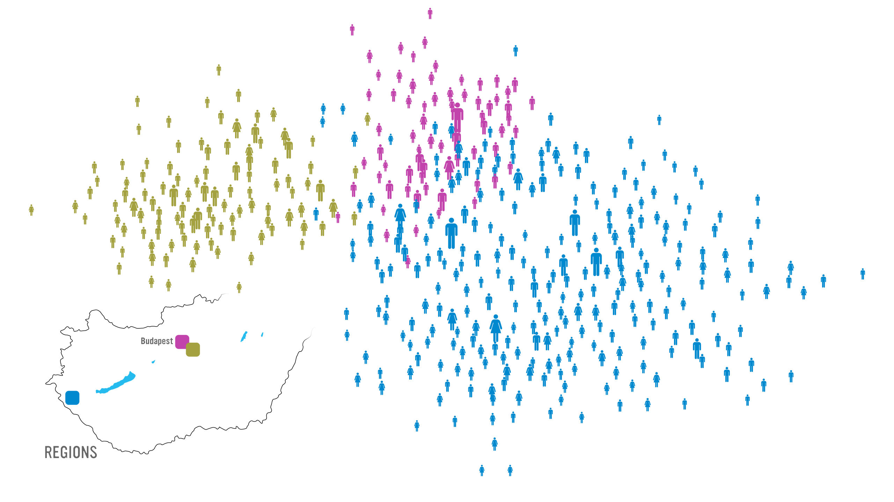
Management
Three divisions: Budapest (management), subs of Budapest (administration), and province (manufacturing
Notes:
While traditionally management uses the official chain of command to understand the inner structure of an organization, it is increasingly evident that the informal network, capturing who really communicates with whom, matters even more for the success of a company. Accurate maps of this network can expose lack of communication between key units, can identify individuals who play an outsize role in bringing different departments and products together, and help higher management diagnose diverse organizational issues. Furthermore, there is increasing evidence in the management literature that the position of an employee within this network correlates with his/her productivity.
Therefore, several dozen consulting companies have emerged with expertise to map out the true structure of an organization. Established consulting firms, from IBM to SAP, have added social networking capabilities to their consulting business. These companies offer a host of services, from identifying opinion leaders to preventing employee churn and from identifying optimal groups for a task to modeling product diffusion (Image 1.10a/b/c/d). Hence lately network science tools are increasingly indispensable in management and business, enhancing productivity and boosting innovation within an organization.
Network science can therefore offer a microscope for higher management, helping them improve the company’s effectiveness by uncovering the true network behind any organization.
30 Let me show you how this works. Start from the list of a company’s employees, colored based on their location. This happens to be a Hungarian company that has three locations, one on Budapest and two others outside of the city.
This is not enough, however: To apply network science, we need a network: we need to know who listens to whom, who is asking for advice from whom. So a social network company, Maven 7, asked each employee: Whom do you ask for advice when it comes to decisions that impact the company, like, restructuring, advancement, and so on?

Slide 26
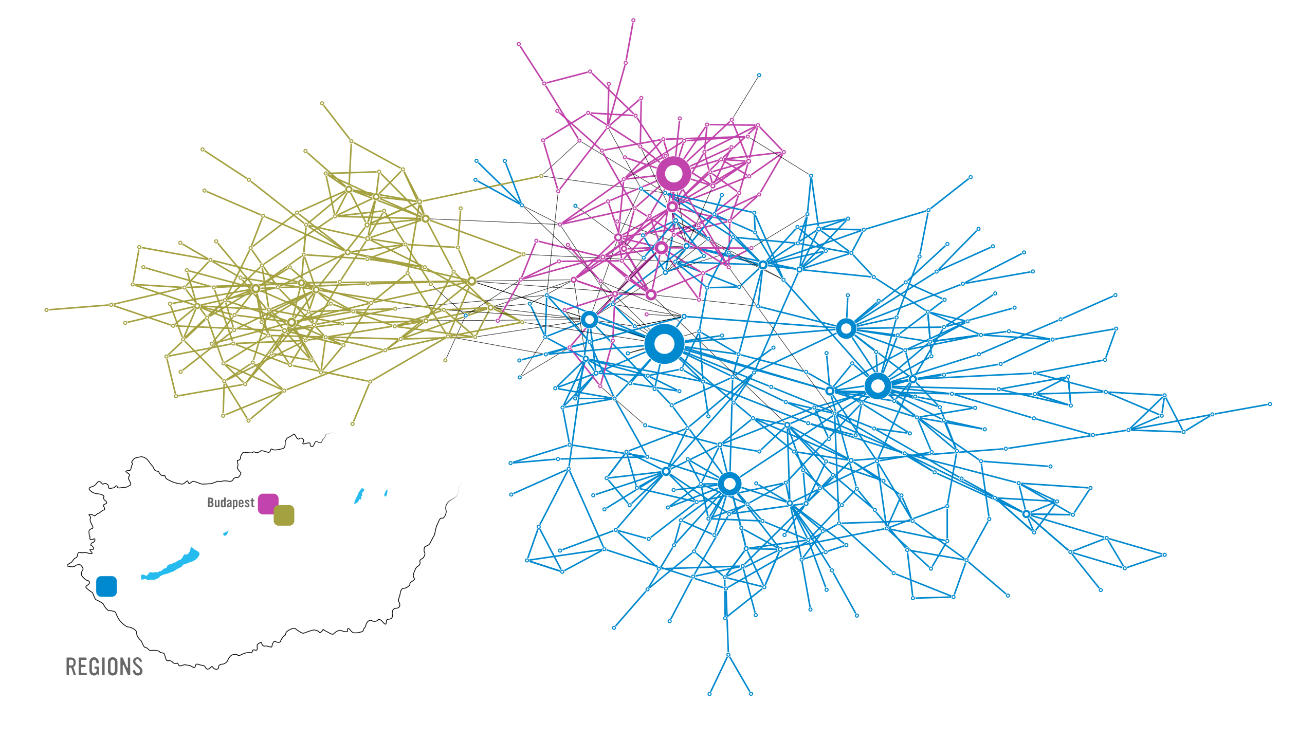
Map of the network, with high degree nodes marked. Low penetration of information from management to others.
Map shows a major internal
communication problem
Notes:
Why did they do map in the first place? The company had a major internal communication problem. The decisions of the higher management did not arrive to the workers, or what arrived had nothing do to with the real decisions. They wanted to find out where was the problem.
The map showed that several individuals do have quite a bit of influence in the company. They are the hubs. The problem was that none of the hubs were part of the leadership.

Slide 27
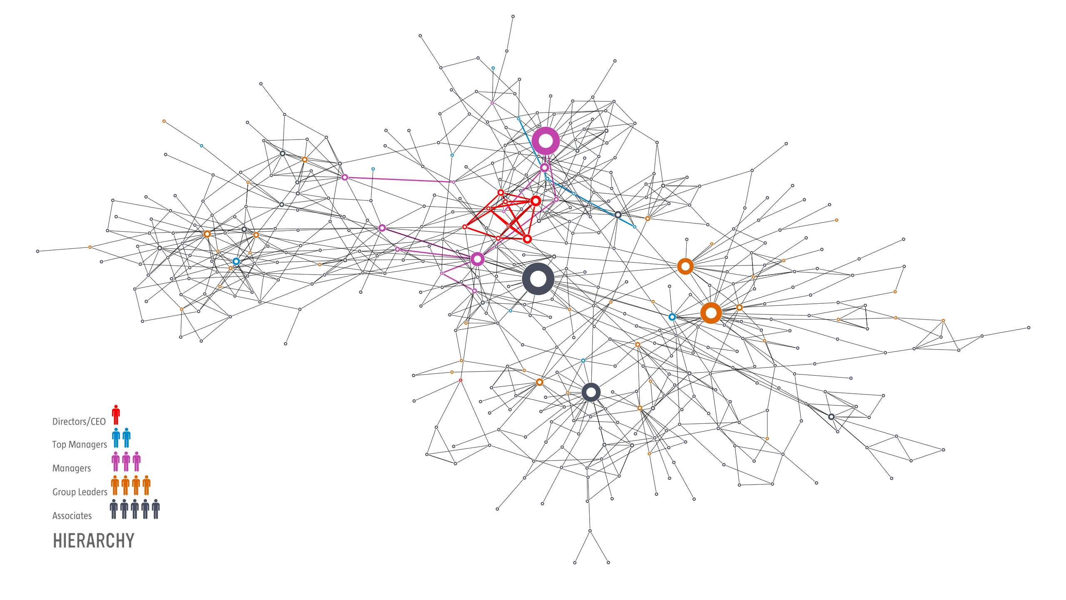
Range of communication
of different rank of
employees, very ranges
for the highest level
of hierarchy
Barabasi Lab
Notes:
30: This is obvious here, where we colored the nodes based on their rank. The biggest hubs are not the company directors or the CEO. They are not part of the top management. Most are associates, a kind way to say, workers.
Who has the biggest influence? The safety and environmental manager. The only person whose job was to visit each location and talk with everyone. He had no links to the higher management. He was passing on information as collected along his trail. He was the oracle, running a gossip center.
So fire the guy? Well, he is not the problem. The problem is that higher management failed to put in place proper channels of communication, leaving behind a structural hole, which this fellow filled in.
But what does this have to do with control?

Slide 28
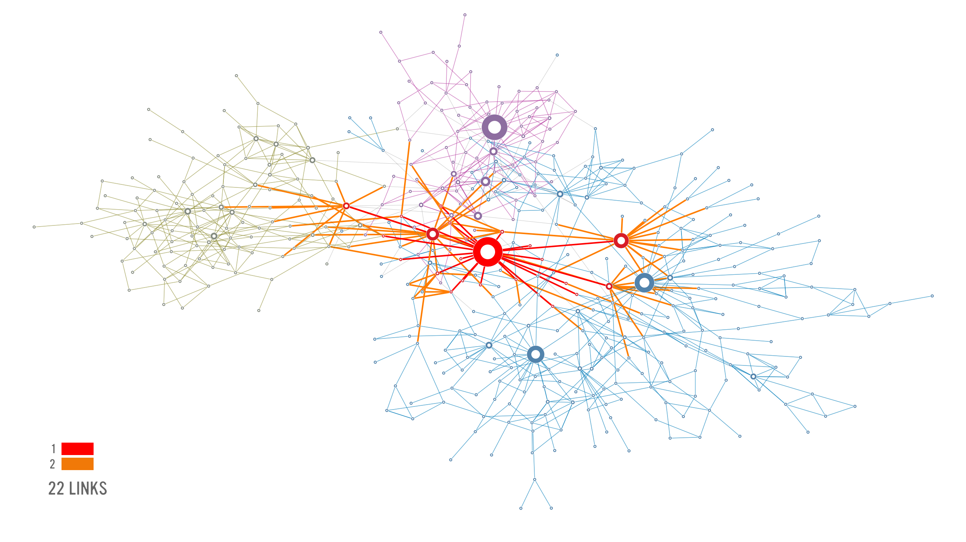
Several uncoordinated
Sources of information
from different levels
of management hierarchy

Slide 29
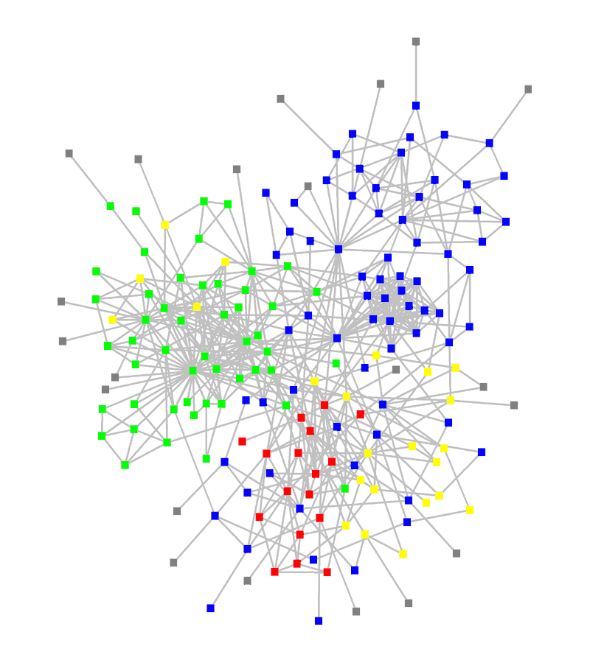
STRUCTURE OF AN ORGANIZATION
: departments
: consultants
: external experts
www.orgnet.com
Network Science: Introduction

Slide 30
The subtle financial networks
Network Science: Introduction
Notes:
{\bf The subtle networks behind the economy.}
A credit card, selected as the 99th object in the popular exhibition by the British Museum, entitled {\it The History of the World in 100 Objects.} This card demonstrates the interconnected nature of the modern economy, creating subtle linkages that one normally does not even think of. The card was issued in the United Arab Emirates in 2009 by the Hong Kong and Shanghai Banking Corporation, commonly known HSBC, a London based bank. The card functions through protocols provided by VISA, an USA based credit association. Yet, the card adheres to Islamic banking principles, which operates in accordance with Fiqhal-Muamalat (Islamic rules of transactions), most notably the elimination of interest or {\it riba}. The card is not limited to Muslims in the United Arab Emirates, but it is also offered to Muslim minorities in non-Muslim countries, and it is also used by many non-Muslims who agree with its strict ethical guidelines

Slide 31
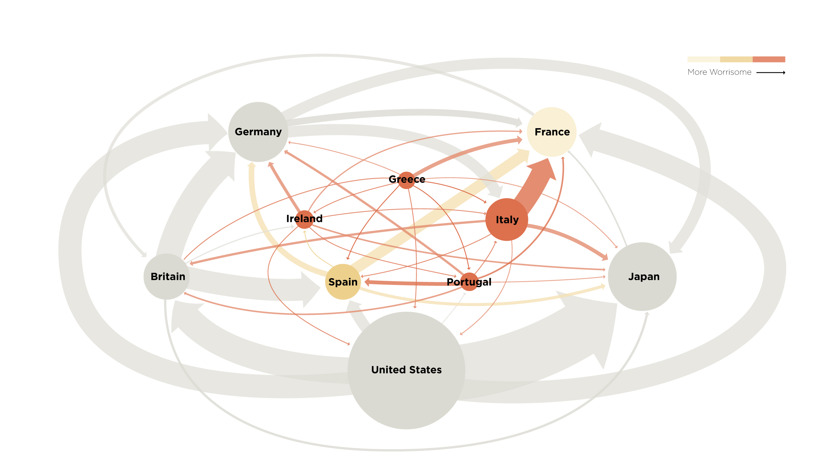
The not so subtle financial networks: 2011
Network Science: Introduction
Notes:
{\bf The subtle networks behind the economy.}

Slide 32
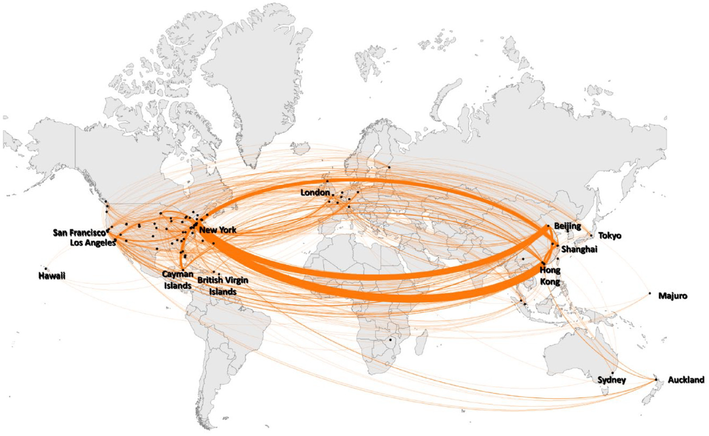
Chinese companies with foreign listings: 2022
Network Science: Introduction
Notes:
{\bf The subtle networks behind the economy.}

Slide 33
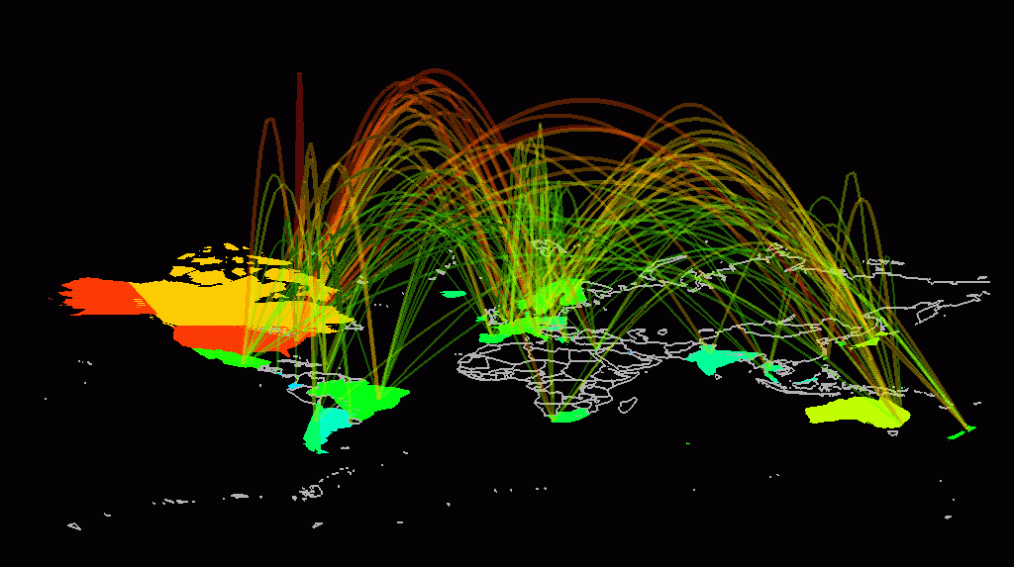
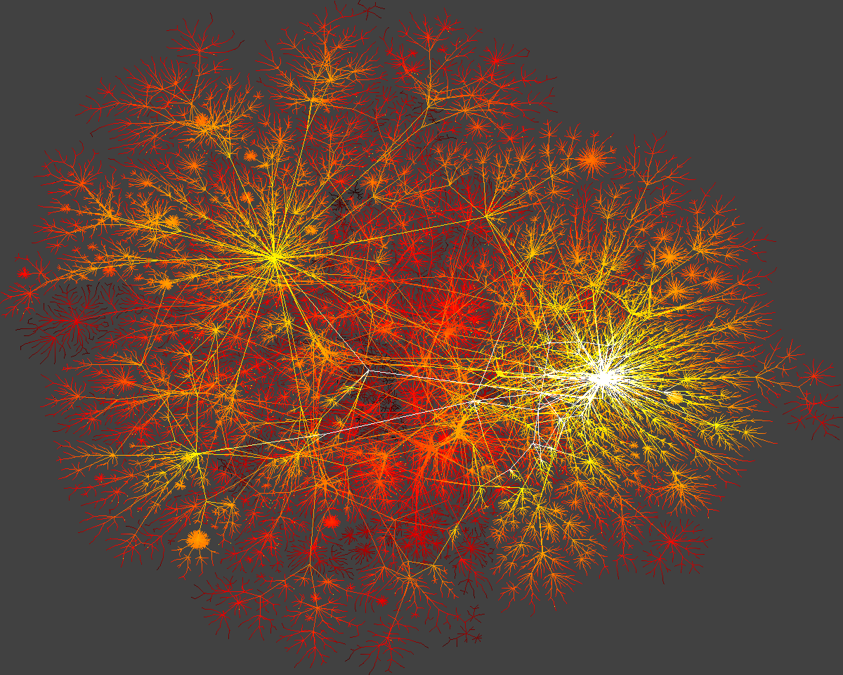
INTERNET
domain2
domain1
router
domain3
Network Science: Introduction

Slide 34
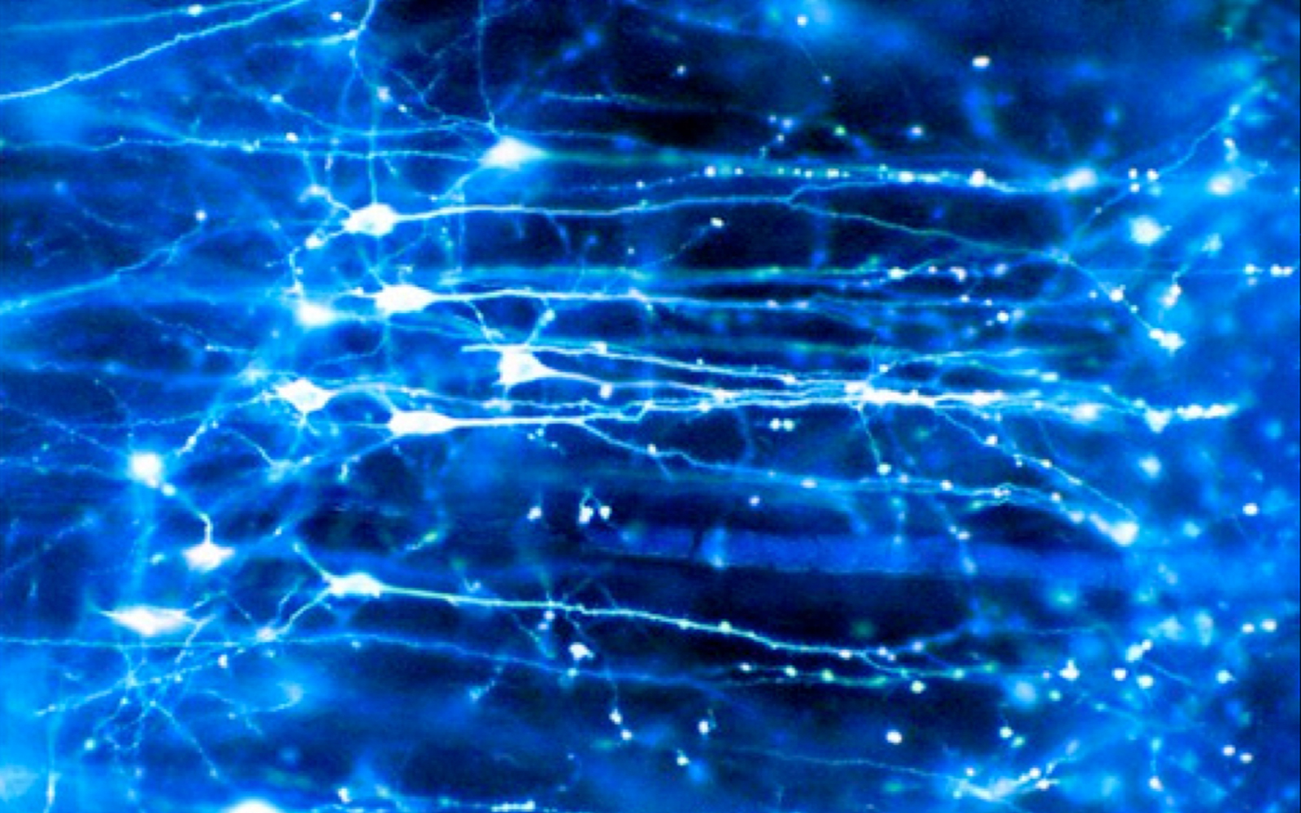
Brain
BRAIN Factoid:
Human Brain has between
10-100 billion neurons.
Network Science: Introduction
Notes:
We are surrounded by systems that are hopelessly complex, from the society, a collection of six billion individuals, to communications systems, that these days link billions of devices, from computers to cell phones. Our very existence is rooted in the ability of thousands of genes to work together in a seamless fashion; our thoughts, reasoning, and comprehension of the world is hidden in the connections between billions of neurons in our brain. These systems, random looking at first, upon close inspection display endless signatures of order and self-organization whose quantification, understanding, prediction and eventually control is the major intellectual challenge for the science of the 21st century

Slide 35
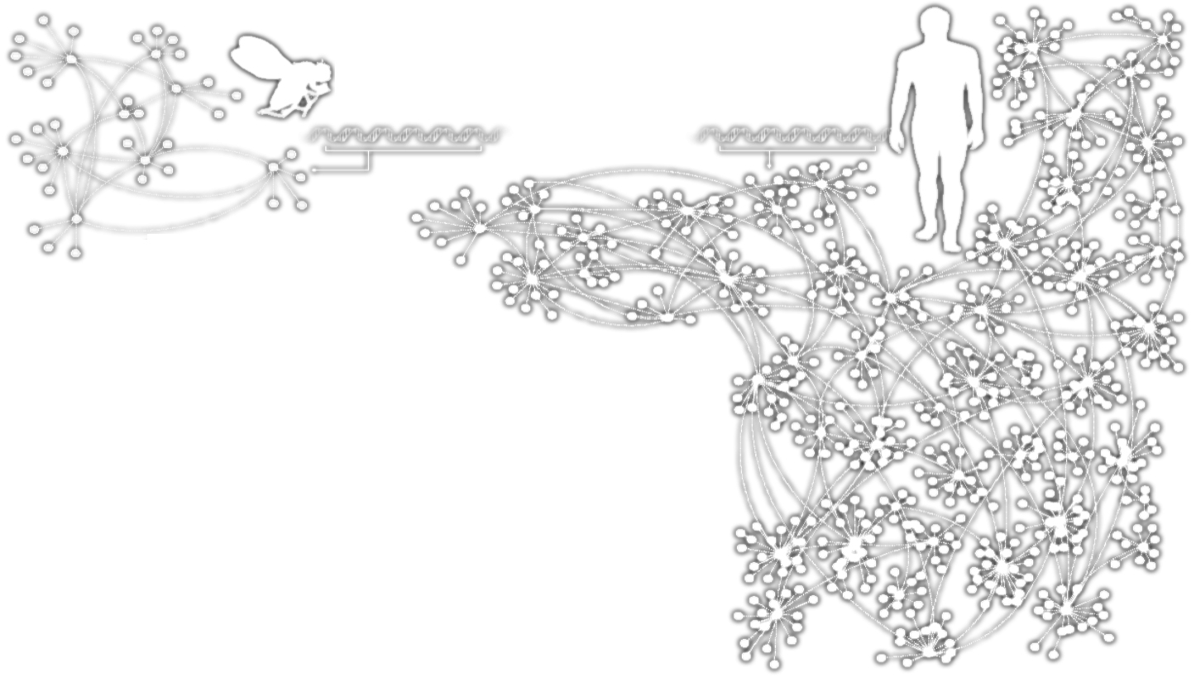
HUMANS GENES
Homo
Sapiens
Drosophila
Melanogaster
Complex systems
Made of many non-identical elements connected by diverse interactions.
NETWORK
Network Science: Introduction

Slide 36
THE ROLE OF NETWORKS
Behind each system studied in complexity there is an intricate wiring diagram, or a network, that defines the interactions between the component.
We will never understand complex system unless we map out and understand the networks behind them.
Network Science: Introduction

Slide 37
Section 5
TWO FORCES HELPED THE EMERGENCE OF NETWORK SCIENCE
Network Science: Introduction

Slide 38
THE EMERGENCE OF NETWORK SCIENCE
The emergence of network maps:
Movie Actor Network, 1998;
World Wide Web, 1999.
C elegans neural wiring diagram 1990
Citation Network, 1998
Metabolic Network, 2000;
PPI network, 2001
Network Science: Introduction
Notes:
The emergence of network maps: To describe the behavior of a system consisting of hundreds to billions of interacting components, we first need a map of the system’s wiring diagram. In a social system, this would require knowing the list of your friends, your friends’ friends, and so on. In the WWW, this map tells us which webpages link to each other. In the cell, this corresponds to a detailed list of binding interactions and reactions that the genes, proteins, and metabolites participate in. In the past, we either lacked the tools to map these networks out, or it was difficult to keep track of the huge amount of data behind these maps. The emergence of the Internet, offering effective and fast data sharing methods, together with cheap digital storage, fundamentally changed this, allows us to collect, assemble, share, and analyze data pertaining to real networks.
While many of the canonical maps studied today in net- work science were not collected with the purpose of studying networks (Box 2):
The list of chemical reactions that take place in a cell were discovered over a 150 year period by biochemists and biologists. In the 1990s they were collected in central databases, offering the first chance to assemble the networks behind a cell.
The list of actors that play in each movie were traditionally scattered in books and encyclopedias. With the advent of the Internet, these disparate data were assembled into a central database by imdb.com, mainly to feed the curiosity of movie aficionados. The database offered the first chance for network scientists to explore the structure of the affiliation network behind Hollywood.
The detailed list of authors of millions of research papers were traditionally scattered in the table of content of thou- sands of journals, but recently the Web of Science, Google Scholar, and other sites assembled them into comprehensive databases, easing the search for scientific information.
We also witnessed an explosion of map making at the end of the 1990s. These offered detailed maps of the networks behind numerous complex system, from cell to the economy. Examples include the CAIDA or DIMES project aimed at obtaining an accurate map of the Internet [8]; the hundreds of millions of dollars spent by biologists to systematically map out protein-protein inter- actions in human cells [6], or the Connectome project of the US National Institute of Health that aims to trace the neural connection in mammalian brains [7].

Slide 39
THE EMERGENCE OF NETWORK SCIENCE
The universality of network characteristics:
The architecture of networks emerging in various domains of science, nature, and technology are more similar to each other than one would have expected.
Network Science: Introduction
Notes:
The universality of network characteristics: It is easy to list the differences between the various networks we encounter in nature or society: the nodes of the metabolic network are tiny molecules and the links are chemical reactions governed by quantum mechanics; the nodes of the WWW are web documents and the links are URLs maintained by computer algorithms; the nodes of the social network are individuals, the links representing family, professionals, friendship, and acquaintance ties.
The processes that shape these networks also differ greatly: metabolic networks are shaped by billions of years of evolution; WWW is collectively built by the actions of mil- lions of individuals; social networks are shaped by social norms whose roots go back thousands of years.
Given this diversity in size, nature, scope, history, and evolution, one would not be surprised if the networks behind these systems would differ greatly. Yet, a key discovery of network science is that the architecture and the evolution of net- works emerging in various domains of science, nature, and technology are rather similar to each other, allowing us to use a common set of mathematical tools to explore these systems.
This universality is one of the guiding principle of this book: we will not only seek to uncover specific network properties, but we will aim to understand its origins, en- coding the laws that shape network evolution, as well as its consequences in understanding network behavior.

Slide 40
THE EMERGENCE OF NETWORK SCIENCE
Data Availability:
C elegans neural wiring diagram 1990
Movie Actor Network, 1998
Citation Network, 1998
World Wide Web, 1999
Metabolic Network, 2000
PPI network, 2001
Universality:
The architecture of networks emerging in various domains of science, nature, and technology are more similar to each other than one would have expected.
The (urgent) need to understand complexity:
Despite the challenges complex systems offer us, we cannot afford to not address their behavior, a view increasingly shared both by scientists and policy makers. Networks are not only essential for this journey, but during the past decade some of the most important advances towards understanding complexity were provided in context of network theory.
Network Science: Introduction

Slide 41
THE HISTORY OF NETWORK ANALYSIS
Graph theory: 1735, Euler
Social Network Research: 1930s, Moreno
Communication networks/internet: 1960s
Ecological Networks: May, 1979.
Network Science: Introduction
Notes:
Why didn’t network science emerge two hundred years earlier? The networks it explores are by no means new: metabolic networks date back to the origins of life, with a history of four billion years, and the Internet is over four decades old. Furthermore, many disciplines, from bio- chemistry to sociology, and brain science, have been dealing with their notion of networks. Graph theory, a prolific subfield of mathematics, has focused on networks since 1735. Why do we dare to call network science the science of the 21st century?

Slide 42
THE TOOLS OF MODERN NETWORK THEORY
> Graph theory
> Social network theory
> Statistical physics
> Computer science
> Biology
> Statistics
Network Science: Introduction

Slide 43
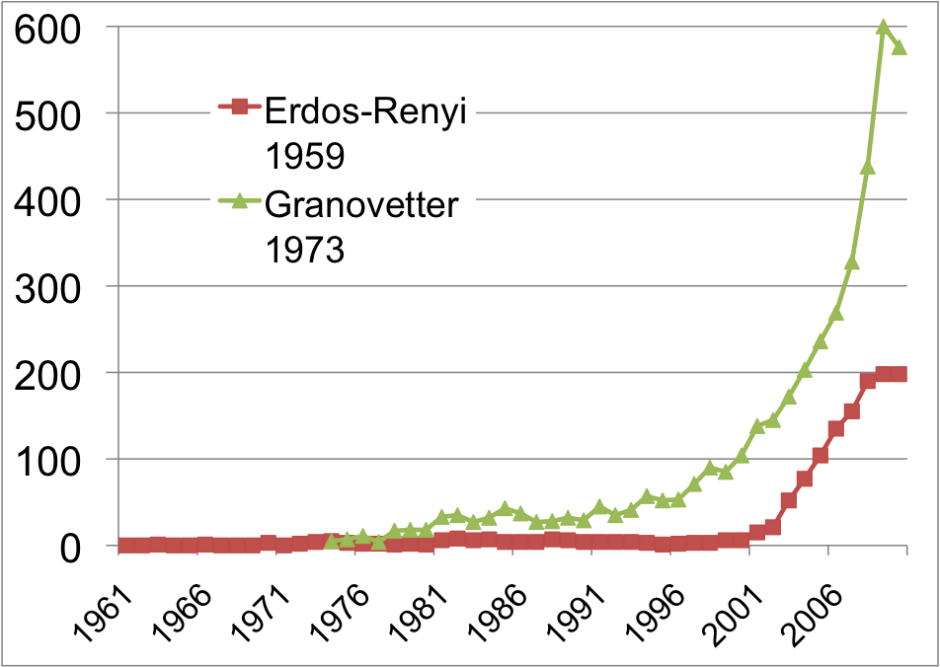
THE HISTORY OF NETWORK ANALYSIS
Network Science: Introduction
Notes:
Something special happened at the dawn of the 21st century that transcended individual research fields and catalyzed the emergence of a new discipline (Image 1.5). To understand why this happened only now, and not two hundred years earlier, we need to discuss the forces that have contributed to the emergence of network science.
While the study of networks has a long history from graph theory to sociology, the modern chapter of network science emerged only during the first decade of the 21st century, following the publication of two seminal papers in 1998 [2] and 1999 [3]. The explosive interest in network science is well documented by the citation pattern of two classic network papers, the 1959 paper by Paul Erdos and Alfréd Rényi that marks the beginning of the study of random networks in graph theory [4] and the 1973 paper by Mark Granovetter, the most cited social network paper [5]. Both papers were hardly or only moderately cited before 2000. The explosive growth of citations to these papers in the 21st century documents the emergence of network science, drawing a new, interdisciplinary audience to these classic publications.

Slide 44
Section 6
THE CHARACTERISTICS OF NETWORK SCIENCE
Network Science: Introduction
Notes:
Network science is distinguished, not only by its subject matter, but also by its methodology. In the following we briefly discuss the key characteristics of the approach network science adopted to understand complex systems, helping us better understand the domain we are about to embark on.

Slide 45
THE CHARACTERISTICS OF NETWORK SCIENCE
Interdisciplinary
Empirical
Quantitative and Mathematical
Computational
Network Science: Introduction
Notes:
Interdisciplinary nature: Network science offers a language through which different disciplines can seamlessly interact with each other. Indeed, cell biologists and computer scientists alike are faced with the task of characterizing the wiring diagram behind their system, extracting information from incomplete and noisy datasets, and the need to understand their systems’ robustness to failures or deliberate attacks.
To be sure, each discipline brings along a different set of technical details and challenges, which are important on their own. Yet, the common character of the many issues various fields struggle with have led to a cross-disciplinary fertilization of tools and ideas. For example, the concept of betweenness centrality that emerged in the social network literature in the 1970s, today plays a key role in identifying high traffic nodes on the Internet; algorithms developed by computer scientists for graph partitioning have found novel applications in cell biology.

Slide 46
THE CHARACTERISTICS OF NETWORK SCIENCE
Interdisciplinary
Empirical, data driven
Quantitative and Mathematical
Computational
Network Science: Introduction
Notes:
Empirical, data driven nature: The tools of network science have their roots in graph theory, a fertile field of mathematics. What distinguishes network science from graph theory is its empirical nature, i.e. its focus on data and utility. As we will see in the coming chapters, we will never be satisfied with developing the abstract mathematical tools to describe a certain network property. Each tool we develop will be tested on real data and its value will be judged by the insights it offers about a system’s structure or evolution.

Slide 47
THE CHARACTERISTICS OF NETWORK SCIENCE
Interdisciplinary
Empirical
Quantitative and Mathematical
Computational
Network Science: Introduction
Notes:
Quantitative and mathematical nature: To contribute to the development of network science, it is essential to master the mathematical tools behind it. The tools of network science borrowed the formalism to deal with graphs from graph theory and the conceptual framework to deal with randomness and seek universal organizing principles from statistical physics. Lately, the field is benefiting from concepts borrowed from engineering, control and information theory, statistics and data mining, helping us ex- tract information from incomplete and noisy datasets.

Slide 48
THE CHARACTERISTICS OF NETWORK SCIENCE
Interdisciplinary
Empirical
Quantitative and Mathematical
Computational
Network Science: Introduction
Notes:
Computational nature: Finally, given the size of many of the networks we explore, and the exceptional amount of data behind them, network science offers a series of formidable computational challenges. Hence, the field has a strong computational character, actively borrowing from algorithms, database management and data mining. A series of software tools help practitioners with diverse computational skills analyze networks.

Slide 49
Section 7
THE IMPACT OF NETWORK SCIENCE
Network Science: Introduction
Notes:
The impact of a new research field is measured both by its intellectual achievements as well as by the reach and the potential of its applications. While network science is a young field, its impact is everywhere around us, as we discuss below.

Slide 50
THE IMPACT OF NETWORK SCIENCE
Quantum Mechanics: 1900
-electron microscope 1931
-transistor 1947
-laser 1957
-magnetic resonance imaging 1973
-quantum computing 2015
Much of modern technology operates at a scale where quantum effects are significant.
At least a 30 year gap between the science and technology.
Network Science: Introduction

Slide 51
ECONOMIC IMPACT
Google vs. Alphabet
Market Caps (August 2023):
$130 billion vs. 1,640 billion
Cisco Systems
networking gear Market Market Cap (August 2023):
$225 billion
Facebook (Meta)
Market Cap (August 2023):
$738 billion
Network Science: Introduction
Notes:
Economic Impact: From web search to social networking.
Some of the most successful companies of the 21st century, from Google to Facebook, Twitter, LinkedIn, Cisco to Apple and Akamai, base their technology and business model on networks. Indeed, Google is not only the biggest network mapping operation, building a comprehensive map of the WWW, but its search technology relies on the network characteristics of the Web.
Networks have gained particular popularity with the emergence of Facebook, the company with the oft-emphasized ambition to map out the social network of the whole planet. While Facebook was not the first social networking site, it is likely also not the last: an extensive ecosystem of social networking tools, from Twitter to Orkut, are attracting an impressive number of users (Image 1.6). The tools developed by network science fuel these sites, aiding everything from friend recommendation to advertising.

Slide 52
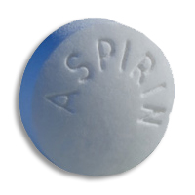
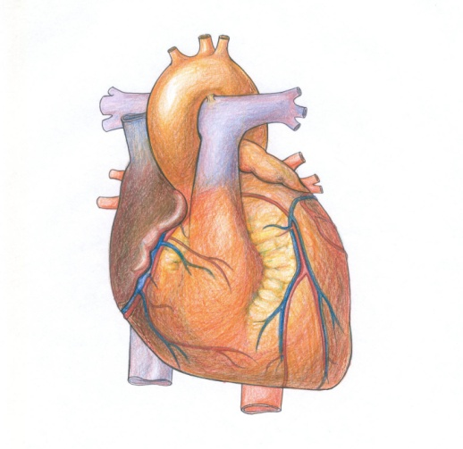
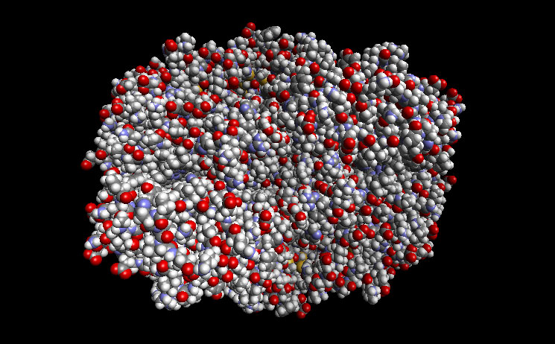
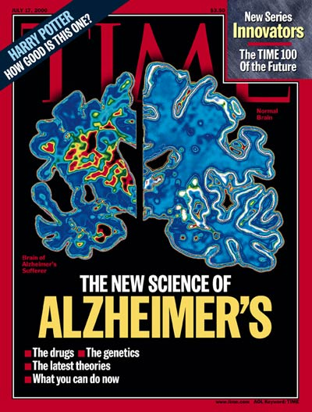
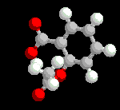
DRUG DESIGN, METABOLIC ENGINEERING:
Reduces
Inflammation
Fever
Pain
Prevents
Heart attack
Stroke
COX2
Causes
Bleeding
Ulcer
Reduces the risk of
Alzheimer's Disease
Reduces the risk of
breast cancer
ovarian cancers
colorectal cancer
Network Science: Introduction
Notes:
Health: From drug design to metabolic engineering.
The human genome project, completed in 2001, offered the first comprehensive list of all human genes. Yet, to fully understand how our cells function, and the origin of disease, we need accurate maps that tell us how these genes and other cellular components interact with each other. Most cellular processes, from the processing of food by our cells to sensing changes in the environment, rely on molecular networks. The breakdown of these networks is responsible for most human diseases. This has led to the emergence of network biology, a new subfield of biology that aims to understand the behavior of cellular networks. A parallel movement within medicine, called network medicine, aims to uncover the role of networks in human disease (Image 1.7a/b). Networks are particularly import- ant in drug development. The ultimate goal of network pharmacology is to develop drugs that can cure diseases without significant side effects. This goal is pursued at many levels, from millions of dollars invested to map out cellular networks to the development of tools and databas- es to store, curate, and analyze patient and genetic data. Several new companies take advantage of these opportuni- ties, from GeneGo that aims to collect accurate maps of celllular interactions from scientific literature to Genomatica that uses the predictive power behind metabolic networks to identify drug targets in bacteria and humans. Recently most major pharmaceutical companies have made significant investments in network and systems medicine, seeing it as the path towards future drugs.

Slide 53
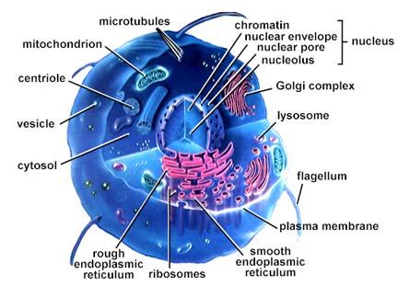
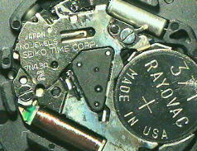
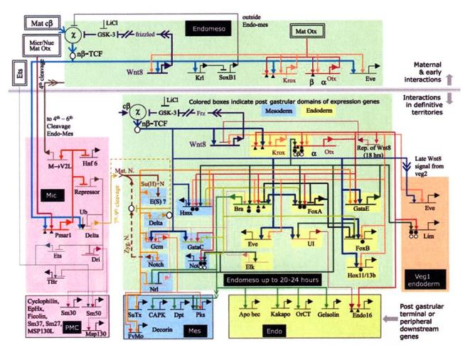
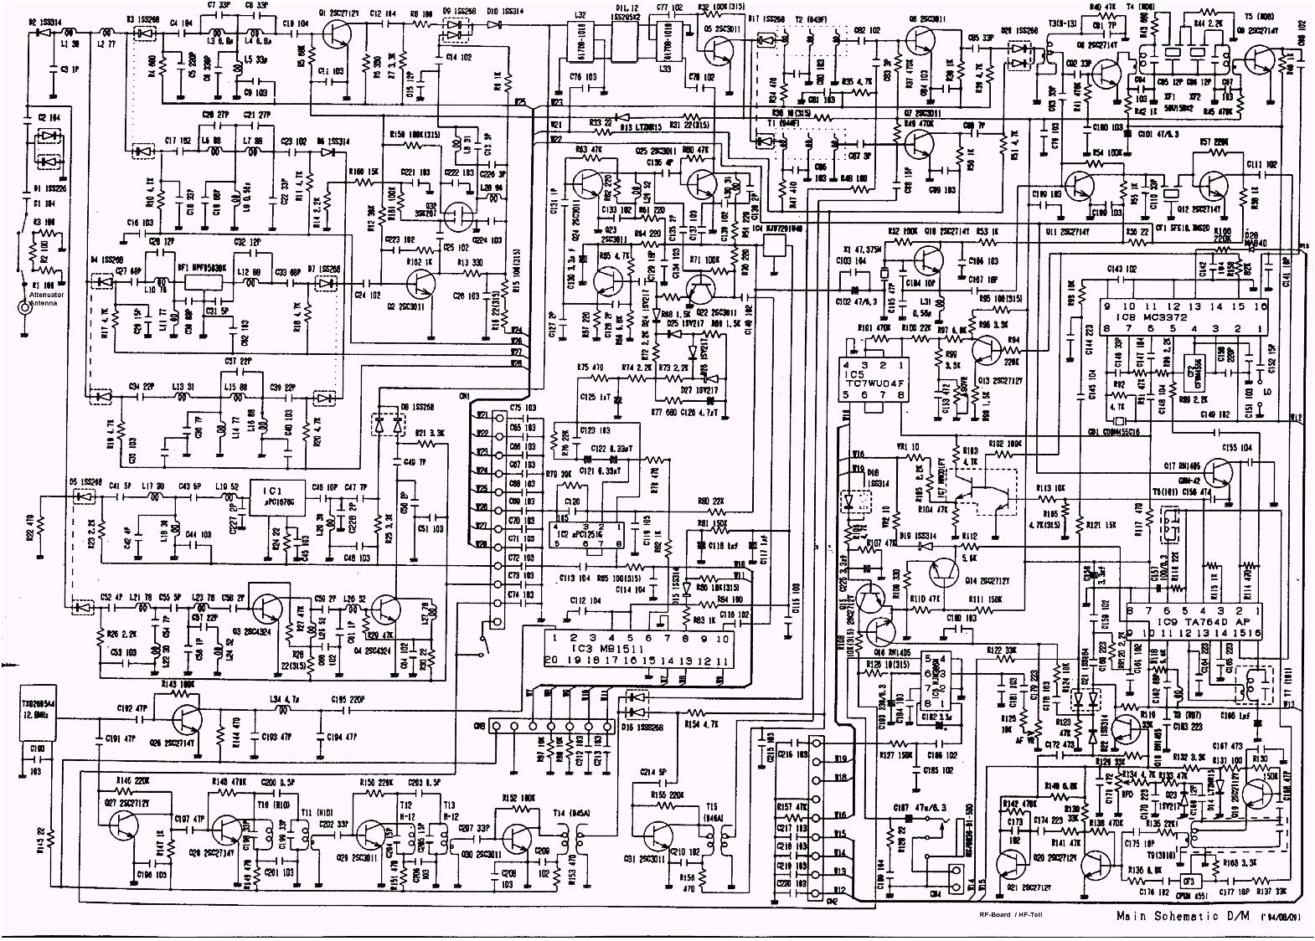
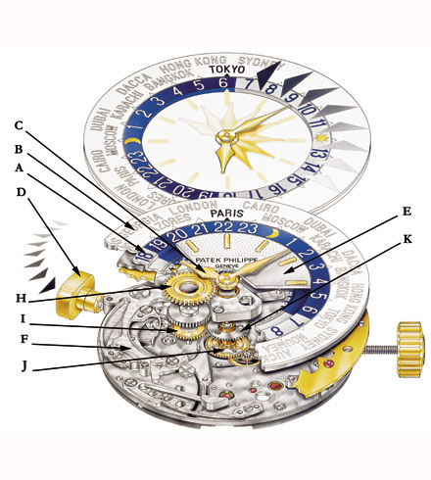
DRUG DESIGN, METABOLIC ENGINEERING:
Notes:
Health: From drug design to metabolic engineering.
The human genome project, completed in 2001, offered the first comprehensive list of all human genes [9, 10]. Yet, to fully understand how our cells function, and the origin of disease, we need accurate maps that tell us how these genes and other cellular components interact with each other. Most cellular processes, from the processing of food by our cells to sensing changes in the environment, rely on molecular networks. The breakdown of these networks is responsible for most human diseases. This has led to the emergence of network biology, a new subfield of biology that aims to understand the behavior of cellular networks. A parallel movement within medicine, called network medicine, aims to uncover the role of networks in human disease (Image 1.7a/b). Networks are particularly import- ant in drug development. The ultimate goal of network pharmacology is to develop drugs that can cure diseases without significant side effects. This goal is pursued at many levels, from millions of dollars invested to map out cellular networks to the development of tools and databases to store, curate, and analyze patient and genetic data. Several new companies take advantage of these opportunities, from GeneGo that aims to collect accurate maps of cellular interactions from scientific literature to Genomatica that uses the predictive power behind metabolic networks to identify drug targets in bacteria and humans. Recently most major pharmaceutical companies have made significant investments in network and systems medicine, seeing it as the path towards future drugs.

